Slide 1


Who Will I Be in 10 Years?
I imagine myself in 10 years as a successful person, not only morally, but also spiritually. I will travel the world.
BY ABDURAKHMAN ABDIBAITOV

Slide 2

My GOALS
Become a programmer
Be Useful
Be a leader in IT
JS engineer
Be useful to society
Create useful things
Software engineer
Be useful
Create my company and be competitive
C++
Be useful to everyone

Slide 3
Educational & Professional Development Plan
1
Continuous Learning
2
Skill development
3
Always practice
/////
+alway practice
//////
+SOFT SKILLS
+learn something new every day and apply it
////////
+HARD SKILLS
////////////

Slide 4


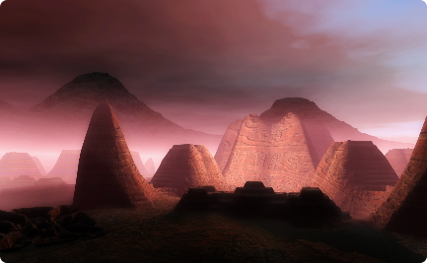
And i will also travel around the world (this is very useful)
Travel with my parents
Travel for benefit
Travel to make your dreams come true
Firstly i will travel with my parents (because this is their dream) and will be a worthy son of my parents.
Travel is very useful.
For example: i want to see the places i dreamed of as a child
Your learn a lot of in traveling (
new places, new friends and more…)

Slide 5

My development plan for 10 years
1
Need to study well and find first jop
(implement my startup)
2
Need to gain experience
(implement my IT startup in real life)
3
And be a leader
(i will open my company and implement my dreams)

Slide 6

Problems in the next 10 years
1
Lazy
flaw money and materials
2
hard to find a job
3
Its hard to find helpful and smart people

Slide 7

Plans & Next Steps
Need to finish studies well
Goal Setting
Surround yourself with people
(studyind foreign languages)

